Slide 1
Learning, Teaching & Assessment
Feedback and
Next Steps
Session 7

Slide 2
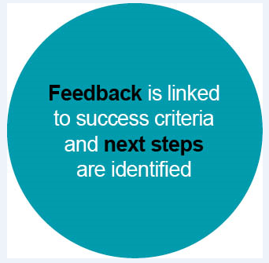
Learning, Teaching and Assessment (Moderation) Cycle
Notes:
The Learning, Teaching and Assessment (Moderation) Cycle
Bubble 7 - Feedback and Next Steps

Slide 3
Aims
To develop an understanding of the importance of feedback and explore the relationship between success criteria and effective feedback.
To identify key features of effective, high-quality feedback and next steps.
To consider existing practice and identify areas for improvement.

Slide 4
What do we mean by “formative feedback”?
Feedback to any pupil should be about the particular qualities of his or her work, with advice on what he or she can do to improve, and should avoid comparisons with other pupils.
Inside the Black Box
Black & Wiliam (1998)
Notes:
This is a definition of formative feedback from Black & Wiliam.
How does it fit with your own thinking?
What makes feedback formative?

Slide 5
All formative assessment should include these 3 elements
Evidence of where they are now
The desired goal
Some understanding of how to close the gap
Notes:
What defines feedback as formative is the presence of comments on quality and advice on how to improve. That being the case, then these are the three elements that all formative feedback should contain:
evidence on where the pupil is now (this is their success as it relates to the agreed criteria, which we discussed in the previous unit);
a definition of the desired goal; and
practical strategies to close the gap.
Image from: https://www.google.com/url?sa=i&url=https%3A%2F%2Fwww.freepik.com%2Ffree-vector%2Fhand-building-bridge_1131112.htm&psig=AOvVaw0RH8qrrWj3Nq4EEs7LIdn0&ust=1639820900871000&source=images&cd=vfe&ved=0CAgQjRxqFwoTCPidqJLH6vQCFQAAAAAdAAAAABAO

Slide 6
Characteristics of formative feedback
Feedback should reference back to the success criteria.
It should clearly state areas of strength.
Feedback should give direction on how to improve.
It should use age and stage appropriate language.
It should be appropriately timed, based on observation of learning.
Time should be given for the learner to reflect and act upon feedback.
Notes:
Note that it’s this advice on how to improve that is critical, as to be truly formative, the feedback must inform the next steps in the learning process. To suggest ‘Work Harder’ isn’t enough. Formative feedback needs to point them towards ways to realise the improvement and reach the goal.

Slide 7
Impact on Learning - The importance of feedback - John Hattie (2015)
Notes:
https://www.youtube.com/watch?v=GioY3nQPSck
1 minute video clip
Assessment is feedback to teachers of our impact, so we can make adjustments that are critical to the learner experience.
Where am I going? How am I going? Where to next?

Slide 8
Why is feedback important?
Ensures learners are clear about what they have done well and what they need to do next to improve through encouragement, support, corrective measures and direction.​
​
Ensures learners are engaged in high quality interactions throughout the learning process​. ​
Supports learners when target setting/ profiling/personal learning planning​ (what knowledge and skills they need to develop communicated using SMART)​.
Provides feedback to teachers of their impact, so they can make adjustments that are critical to the learner experience.
Notes:
Providing learners with marks or grades doesn’t indicate to the learner what they need to do to improve. When marks and grades are accompanied by comments, pupils generally ignore the comments. Black and William (1998) Comparisons and poor marks can result in pupils becoming demotivated. SMART Specific, Measurable, Achievable, Realistic and Timed. Feedback DURING the learning!​
Hattie video clip on slide before:
Assessment is feedback to teachers of our impact, so we can make adjustments that are critical to the learner experience.
Where am I going? How am I going? Where to next?

Slide 9
Why is feedback important?
Focuses on improvement
De-emphasises competition
Improves motivation and learning ambition
Highlights the difference between actual learning and desired learning.​
Notes:
Now let’s talk about why formative feedback is so important.​
​
Let me start by asking you a question: Who marks/grades every piece of work/activity their pupils produce? What’s the ratio of marked activities to unmarked activities? 80/20? 50/50? 25/75?​
I ask because many of us put a lot of time into marking pupils’ work, and this is useful for proving the learning. But the question, in terms of AfL, is: Does a mark help the pupil?​
​
Research says the answer is NO. For example, telling a pupil that they scored 4 out of 10 tells them that they are not achieving, but it says nothing about how to do better.​
​
In addition, over-emphasis on, and over-use of, grades and marks can create a competitive culture in your classroom. Research indicates that this leads to high achievers becoming complacent and low achievers becoming demotivated.​
​
Carol Dweck’s work on students’ motivations - She found that feedback in the form of gold-stars, grades, or place-in-class ranking focuses students on performance rather than their learning.​ As a result, learners actively avoid risk and extending themselves during new learning in order to ensure they secure the reward.​

Slide 10
Dylan Wiliam: Feedback on Learning (3mins)
Notes:
https://www.youtube.com/watch?v=n7Ox5aoZ4ww - 3 minute video clip
In this clip Dylan Wiliam reviews the importance of giving learners effective feedback as an integral component of formative assessment.
After video - pause to discuss the comments about “ego involving” and “task involving” feedback. Do you agree with his comments? Is there a place for “ego” feedback?
Sometimes “ego” feedback is exactly what a learner needs in that moment in time. You as a practitioner will know that because you’ll know your learners. Take on board what Dylan Wiliam says that is it not the most effective - so we do need to make sure we use “task” feedback too. Motivation and engagement are key to learning and teaching. We need to give some of the ego-involving feedback to build relationships with the learners.
He says “Good feedback causes thinking”

Slide 11
Types of Feedback
Oral Feedback
Written Feedback
During the lesson / activity
Personal and immediate
Interactive / 2-way
Tends to be after the completion of the task
Comments or grades
Notes:
There are two types of feedback that may be given to pupils: oral and written.
Oral feedback is usually given during the lesson and written tends to be given after a task/ homework.
Oral feedback can be underestimated because it is less formal, but it can be a very powerful and effective tool.​
This is especially true for younger pupils, because it is personal and immediate.​
It’s also interactive, allowing pupils to respond and participate.​
​
The second type of formative feedback is written feedback.​
Written feedback tends to be given after a task/homework.​
Also, there is a very strong argument for making written feedback comment only, which we’ll talk about in a minute.​

Slide 12
Types of Feedback
Teacher to Pupil Feedback
Pupil to Pupil Feedback
Pupil to Teacher feedback
Learner to teacher feedback is more important than teacher to learner feedback.​ (Hattie and Clark, 2019)

Slide 13
All the elements of formative
assessment come into play as the
feedback happens…. The success criteria are the key focus for discussing best bits and improvement needs. Talk partners discuss the visualiser work and their own work cooperatively, articulating their thoughts and learning from each other.​
Outstanding Formative Assessment ​(Summary)
Shirley Clarke (2014)
Notes:
The feedback helps to round up what you and the learner have been doing.
The success criteria should be a clear focus.
Learner should be involved in dialogue.
Ongoing conversation about learning and next steps.

Slide 14
Pause for thought
Effective Oral Feedback
Look at the examples of feedback for this lesson.
Which ones are effective? Which ones could you improve?
Example
Activity: Pupils cut out, order and glue pictures of a story in sequence ​
We are learning to: Sequence events​
Success Criteria: The pictures will be in the same order as the story we read.
Feedback 1
You are getting better at cutting out. Well done!
Feedback 2
Good strategy, you have cut out all the pictures first so you can shuffle them around and change your mind.
Feedback 3
Well done. I see you have got the first picture in place. What happened next in the story?
Feedback 4
Good job, you have glued that picture very neatly.
Notes:
In this activity, have a look at the speech bubbles and discuss how effective each comment is in providing feedback.​
Feedback 1 - what does “getting better” mean? What skills have improved? How do you know I have improved?
Feedback 2 - Much more effective. Feedback is explaining the parts of the process that I have done well.
Feedback 3 - Encouraging me with what I have done well so far, and giving a prompt for what I might do next.
Feedback 4 - Is gluing neatly part of the success criteria? Have I got the sequence right?

Slide 15
Effective Written Feedback
Find 1 or 2 successes against the success criteria​.
Find the part of the work that has most scope for an immediate ‘jump’ (not simply the worst part!)​
Write a short prompt telling the child exactly what to do to this part of their work​.
Provide time for them to read, process and respond to your prompt.
Notes:
Written feedback needs to have a purpose.
For it to be used formatively, there needs to be the opportunity for next steps and time to act upon the feedback in order to make improvements.
If you’re focusing on giving comments, then your comments must be more than just “work harder”. The feedback must be constructive and help to drive the learning forward.
This slide provides a framework for providing written feedback.
This is only one approach and can be used as often as manageable.
It can be used alongside other types of assessment, and you should explain it to pupils before you introduce it as a strategy.
First, find two successes. By identifying two successes, you are showing pupils where they are now — where they have achieved success in relation to the learning.
Then identify an area of the work that they can immediately improve. This might not be the ‘worst’ aspect of their work. You should identify an achievable and realistic goal.
Next, provide them with a prompt on how to improve. A prompt gives them a practical strategy to close the gap.
Finally, remember that pupils need to be given time to improve.
You don’t have to write huge amounts; you can use symbols instead. Examples of structured feedback that you may already be familiar with are ‘two stars and a wish’ or ‘tickled pink and green for go’.

Slide 16
Effective feedback is at the heart of a formative approach to assessment. ​
Feedback is powerful but variable on its impact on learning.​
Scores or comments with no focus on improvement might interfere with learning.​
Prior knowledge is the starting point for feedback.​
Feedback is about closing the gap between current and desired learning.​
Learner to teacher feedback is more important than teacher to learner feedback.​
Effective feedback occurs when it is received and acted upon.​
Visible Learning: Feedback
Hattie and Clarke (2019)​

Slide 17
Building feedback into day-to-day learning
Mid-lesson reviews using the Success Criteria
Sharing examples of work mid-lesson
Plenary sessions (hinge questions)
Effective questioning and interventions during lessons
Discussions and verbal feedback
Giving time to respond to written and verbal feedback from previous lesson at the start of the next lesson
Opportunities for learners to engage in self and peer assessment.
Editing sessions for writing lessons
Notes:
Too often feedback given comes too little, too late, or too vague.
If we make sure our feedback includes the three elements just discussed, then we eliminate the risk of our feedback being vague. (evidence of where now, how to close gap, desired goal)
But what about the timing? When should we be offering the feedback?
Ideally, formative feedback should take place during the learning.
Feedback can be given as pupils work on a task or assignment. Once they’ve submitted their work, that doesn’t mean the learning has to end there. Instead, you can extend the learning process by offering feedback and:
allowing time for improvements to be made (give your feedback and let them go away, try to follow the advice, and improve the work).
This allows the pupils to take the feedback on board and immediately:
make efforts to close the gap; and
realise the improvement.
This is more effective and productive to the learning experience than end-of-task feedback measures (usually summative), which require pupils to remember the feedback and apply your recommended strategies to a future task.
Importance of building in time for feedback and planning how and when you are going to do this​
Emphasise that feedback can be given by the practitioner and/or the learners​
Opportunities should be given for self and peer assessment​

Slide 18
Building feedback into the learning:
from the beginning
Effective questioning and interventions during lessons.
Starting point for feedback is prior knowledge.
Tell me more about…
Tell me what you have done here.
What are you going to do first?
What do you mean by…?
Can you develop on that?
So how is this one better than that one?
How could you make this even clearer?
Give me an example of what you mean by…
Notes:
Importance of building in time for feedback and planning how and when you are going to do this​
Asking probing questions – where is your starting point? How much do they already know? Is the knowledge embedded or surface?​
Find out about their prior knowledge and then check for understanding of the key teaching point​

Slide 19
Building feedback into the learning:
during learning
5 minute walk about to assess level of understanding
Make a decision about the best kind of feedback
teacher and group
teacher and pupil
pupil as teacher
peer coaching
whole class stop - clarify/explain
Refocus the learners on the learning intention and success criteria
Mid lesson review
Display examples on a visualiser/screen cast
Review a common mistake
Notes:
Importance of building in time for feedback and planning how and when you are going to do this​
Emphasise that feedback can be given by the practitioner and/or the learners​
Opportunities should be given for self and peer assessment​
Try to demonstrate different examples so pupils know there is more than one way of doing something​

Slide 20
Building feedback into the learning:
after learning
Discussion with teacher
1 to 1 conversation
Peer and self assessment
Marking comments - only if they deepen the learning
Rotational marking (group a week)
Correction codes / marking schemes
Whole class feedback
Universal comment bank
Notes:
1-1 conferencing can lessen the need for so many written comments
Find ways to make the feedback most effective
Remember feedback after the learning must include time for the learners to act and respond to the feedback.

Slide 21
Demonstrating a commitment to learning for all
We need to reinforce a shared belief that all children have the capacity to learn by emphasising progression in learning rather than performance.
This can help promote self-belief and personal satisfaction on completion of tasks, because pupils can feel secure in coming up with their own ideas, thinking out loud and explaining their reasoning.
Notes:
Rewarding performance is less effective as some pupils will always perform well with little to no effort but you will have pupils who don’t perform really well but for them have made tremendous progress.
Especially important while we are in this Recovery stage from School closures (2020/21)

Slide 22
Success Criteria and Feedback
Feedback is focused on the agreed set of success criteria.
Both learner and practitioner are clear about what is being assessed and what the feedback will be based on.
Learning Intention: Use notes to create a new text.
Success Criteria I have read my notes carefully to check I understand​. I have written using my own words​. I have used the headings to structure my text in paragraphs​. I have included the key information from my notes. | Possible feedback You have used your notes well to organise your writing into paragraphs. You have included the key information. Can you improve the highlighted sections by re-writing them using your own words?
Notes:
Feedback must be focused on agreed set of success criteria​
Do not try to assess too much - think if the learner can only improve one thing about this what’s the most important in terms of the purpose of the lesson​
Might need to explain this to parents​
​To ensure the feedback is focused we have to very clear about the purpose (Learning Intenion) and therefore the success criteria​
Make link between Success Criteria and feedback/next steps​
Success Criteria must be clearly focused on the Learning Intention to avoid asking learners to consider too much at one time​
Emphasise the importance of not assessing everything all the time – keeping assessment focused around intended learning​
Although we might want to comment on spelling and grammar, if these are not the focus of the learning for this lesson/block of learning, they should not be the focus of the feedback Perhaps have checklists- things we always expect on wall​

Slide 23
Next Steps
What are the next steps if the learner has met the success criteria?
Learner has completed a block of work on multiplying 2-digit numbers.
Next steps should not simply refer to the next section of teaching.
Next steps should not be about activities.
Well done! You have achieved all the success criteria, now you are ready to begin learning about decimals.
Notes:
The next steps here do not relate at all to what the learner has been working on - multiplying 2-digit numbers.
** animations - red X appears after talking through the slide

Slide 24
Next Steps
What are the next steps if the learner has met the success criteria?
Breadth of learning
Challenge in learning
Application of learning
Learner has completed a block of work on multiplying 2-digit numbers.
Learner has been creating notes and researching about life in another country.
Well done! You are able to multiply your tens and units digits accurately. You have added them together accurately too.
Now you are ready to multiply 3 digits. Can you think how you might do this?
Now you might use your notes to create a new text such as a leaflet, to compare life in India with life in Scotland.
Notes:
The feedback here relates directly to the learning that was taking place, and identifies what the next step would be to progress within this area of learning.
The second example gives a way to apply the learning in another context.

Slide 25
Effective Feedback Animation (3min)
Notes:
https://youtu.be/LjCzbSLyIwI (3 minute video)
Helps to improve teaching and learning.
Can improve student learning by up to 8 months.
What is evidence based feedback?
Goal setting
Gathering evidence
Providing clear instruction for next actions to improve performance.
References Black & Wiliam, and Hattie & Timperley research.

Slide 26
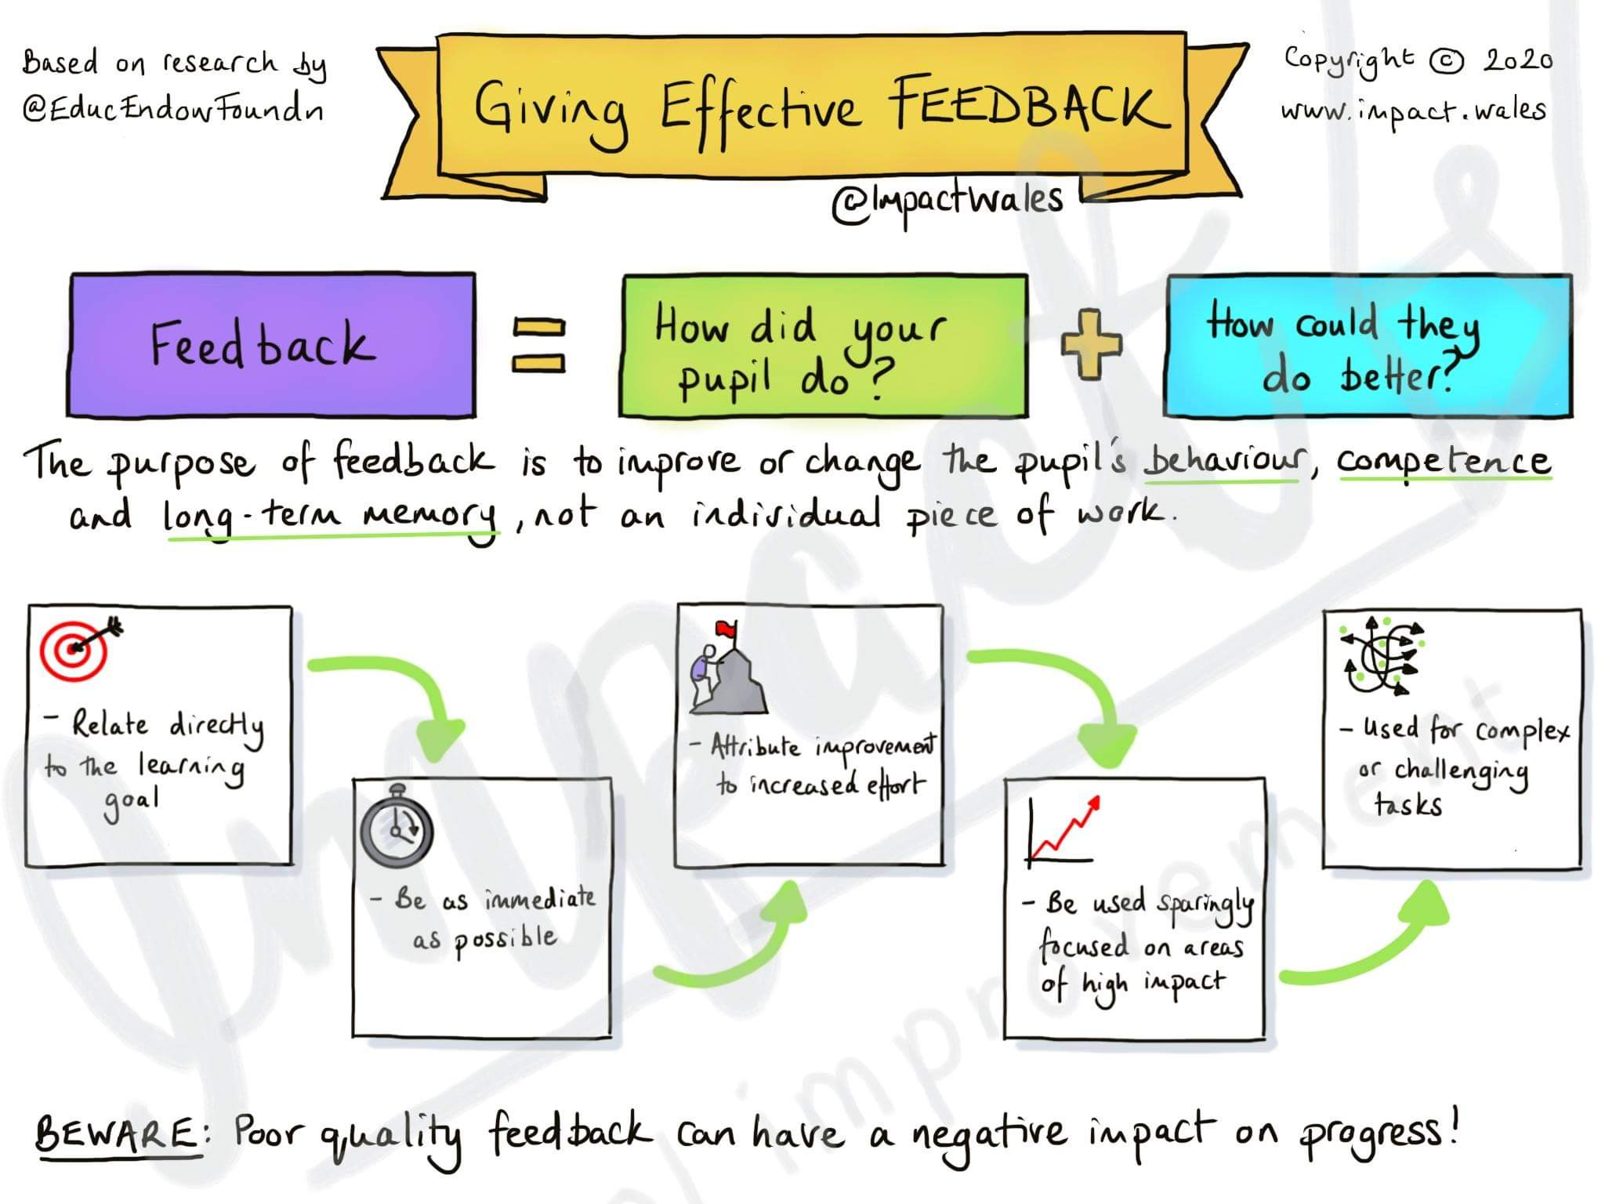

Slide 27
Reflective Questions​​
Are the learners receiving on-going feedback on their work?​
Is this based on the Success Criteria?​
Does the feedback outline what they did well based on Success Criteria?​
Does the feedback describe what they need to do to improve based on Success Criteria?​
Does the feedback state areas of success?​
Does the feedback state what the learner’s next steps are?​
Does the feedback include a mix of self, peer and practitioner assessment?​
Are the learner’s next steps clear?​
Could a learner set appropriate targets from the feedback?​
In what ways is the feedback formative?​
Is it timely?

Slide 28
Further Information
Education Scotland - Moderation Hub - Feedback and Next Steps
Carol Dwyer and Dylan Wiliam (2010) - Using Classroom Data to Give Systematic Feedback to Students to Improve Learning
Black & Wiliam (1998) - Inside the Black Box
John Hattie (2018) - Collective Teacher Efficacy (10 minute video clip)
John Hattie and Helen Timperley (2007) - The Power of Feedback
Summary of Hattie and Timperley research - The Power of Feedback (4 minute video clip)
John Hattie (2017) - Types and Purposes of Feedback (5 minute video clip)
Shirley Clark (2013) - Shirley Clarke video on feedback (8 minute video clip)
TED Talks with Nick Coles (2019) - Effective Feedback without Marking (23 minute video clip)
Ron Berger - Story of Austin’s Butterfly - Critique and Feedback (7 minute video clip)

